Slide 1
Secure Data Hiding in Images Using Steganography
CAPSTONE PROJECT
Presented By: Sugavasi. Harsha Vardhan
Student Name : Sugavasi. Harsha Vardhan
College Name & Department : JNTUA College of engineering, Pulivendula & E.E.E

Slide 2
OUTLINE
Problem Statement
Technology used
Wow factor
End users
Result
Conclusion
Git-hub Link
Future scope

Slide 3
Problem Statement
The problem of secure data hiding in images using steganography involves developing a method to efficiently conceal secret information within an image without compromising its visual quality. Additionally, it is essential to ensure the hidden data remains secure through encryption techniques, preventing unauthorized access. The goal is to create a robust and secure system for covert communication. The method must balance between data capacity, security, and image integrity.

Slide 4
Technology used
Libraries Used:
cv2 (OpenCV) Library:
Purpose: Used for reading, manipulating, and saving images. OpenCV is a widely-used library for computer vision tasks, and here it is specifically used for loading the image (cv2.imread()), manipulating pixel values, and saving the modified image (cv2.imwrite()).
os Library:
Purpose: Used for interacting with the operating system, in this case, for opening the saved image file automatically (os.system("start encryptedImage.jpg")), which works on Windows. The os library can also handle other OS-level tasks like file manipulation and directory operations.
string Library:
Purpose: This library provides common string operations and constants. Although in this code, the library is imported but not actively used, it could be used to generate a sequence of characters (like lowercase or uppercase letters) in more complex scenarios
Platform/IDE:
Python environment (any IDE such as VS Code, PyCharm, or Jupyter Notebooks)
Operating System: Windows (for the current version of the code)
Image file (e.g., mypic.jpg)

Slide 5
Wow factors
This project stands out because it combines basic steganography with password protection, ensuring both security and privacy for hidden messages. It also stands out by integrating image manipulation techniques that ensure the hidden data does not affect the image’s perceptual quality, while maintaining usability across multiple platforms. The simplicity of the encoding/decoding process, combined with the optional security layer of password protection, makes it a unique and effective tool for anyone interested in secure data transmission.

Slide 6
End users
The end users of this project are primarily those who need secure communication, data privacy, and covert data transfer. The project appeals to individuals and organizations concerned with sensitive information, ranging from cybersecurity experts and privacy-conscious individuals to journalists, developers, and students. The ability to embed data securely within images makes it a versatile tool for anyone needing to protect or conceal important messages.

Slide 7
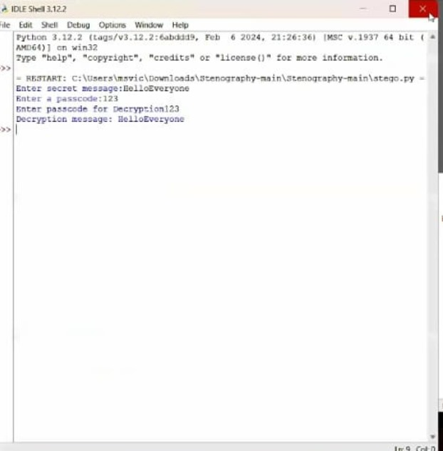
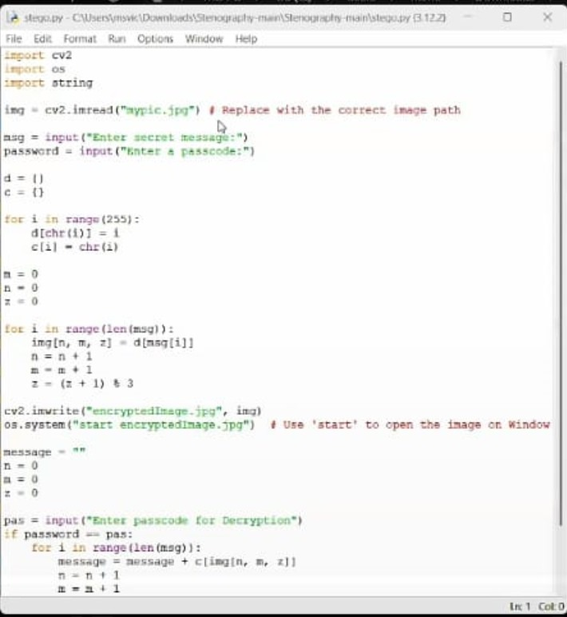

Results

Slide 8
Conclusion
This project on Secure Data Hiding in Images Using Steganography successfully addresses the need for a covert and secure way to hide sensitive information within digital images. By integrating a password protection mechanism along with direct pixel manipulation, it ensures that the embedded data remains secure, private, and undetectable by unauthorized users.
Overall, the project successfully balances data capacity, security, and image integrity, meeting the primary goal of enabling secure communication through the use of steganography. It is an ideal tool for privacy-conscious individuals, cybersecurity professionals, journalists, and developers seeking secure methods to protect and communicate sensitive information, ensuring that data remains hidden even in a visually unchanged image.
In conclusion, this project demonstrates the potential of image-based steganography for secure data transmission and highlights the importance of using encryption alongside data hiding techniques to maintain confidentiality in today's digital world.

Slide 9
GitHub Link
https://github.com/HarshaVardhan12334u/HarshaVardhan12334u.git

Slide 10
Future Scope for the "Secure Data Hiding in Images Using Steganography“
The future scope of this project holds vast potential to evolve into a comprehensive tool for secure communication and data privacy. By incorporating advanced encryption, machine learning, cross-media support, and real-time data transfer, this project could significantly improve its ability to hide information securely and make it applicable to a wider range of use cases. It could become an essential tool in areas such as cybersecurity, privacy protection, digital forensics, and covert communication.
Future scope(optional)

Slide 11
THANK YOU

